Slide 1
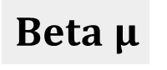
Testes de Bombeamento
$$Beta μ$$

Slide 2
Q(m³/d)
h₀
t₀
h₀
h₃
h₁
t₁
Q _{ON}
h₁
h₂
Q _{OFF}
h₂
t₀
t₁
t₂
t ₃

Slide 3
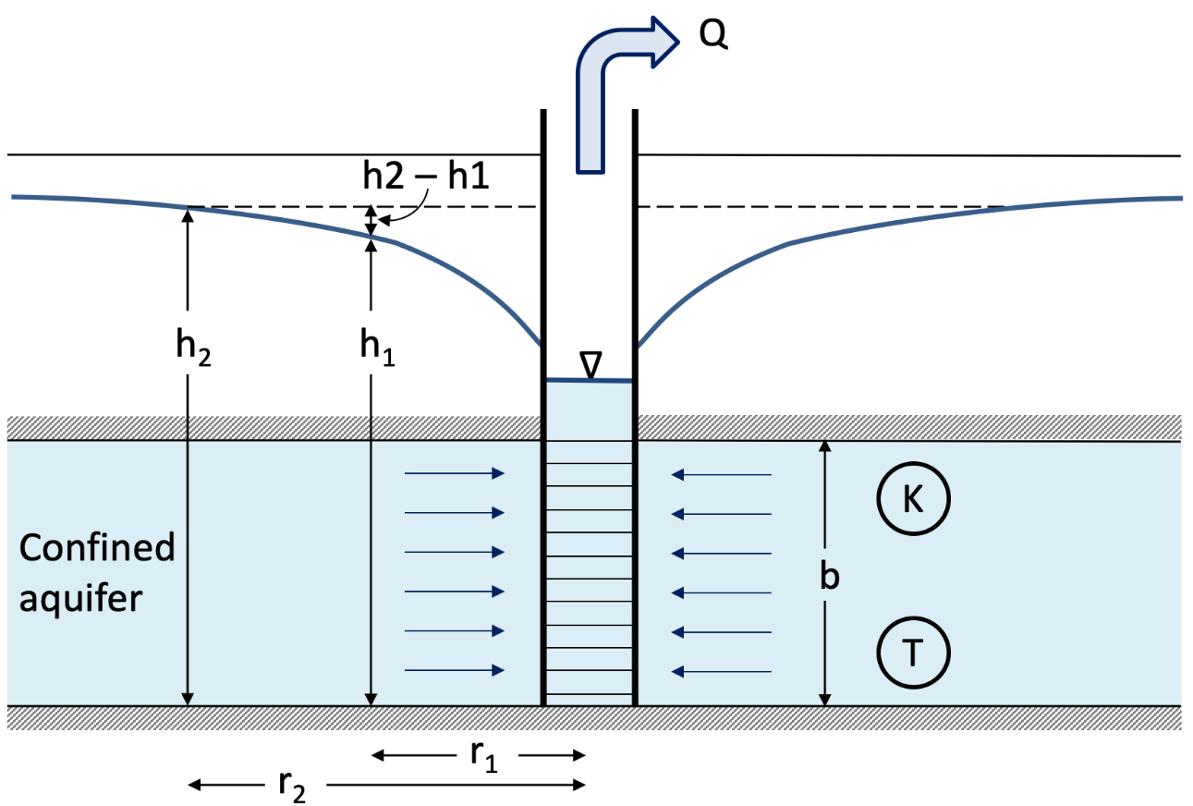
Q(m³/d)
Q(m³/d)
h₀
t₀
h₁
t₁
h₂

Slide 4
Q (m³/d)
Piezômetro
Longe do poço
h₀
t₀
h₁
t₁
Bomb.
h_{0, 3}
h₂
h₁
Q _{on}
Skin effect
h₂
Q _{off}
t₀
t₁
t₂
t ₃

Slide 5
Slug
h_{0, 3}
Q _{on}
h₁
Poço
Q _{off}
h₂
t₀
t₁
t₂
t ₃
Slug test

Slide 6
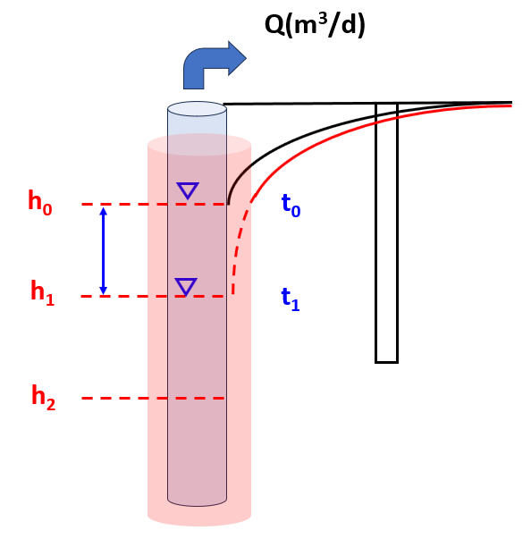
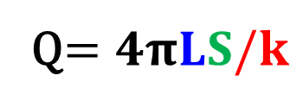
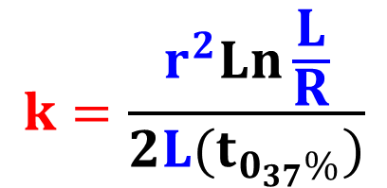
$$k=\frac{r^{2}Ln\frac{L}{R}}{2L{(t}_{0_{37}\%})}$$
Q$=4πLS/k$
r
R
L

Slide 8
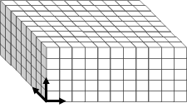
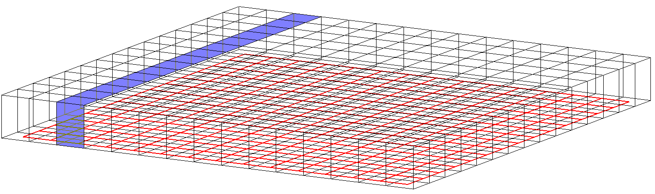
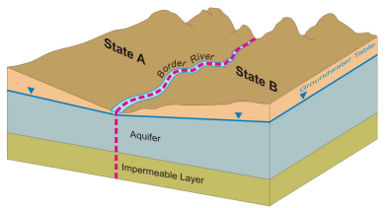
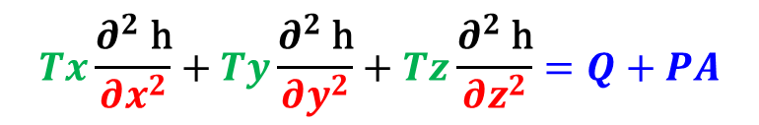
Modelagem Matemática
2D
3D
$$Tx\frac{∂^{2} \text{h}}{∂x^{2}}+Ty\frac{∂^{2} \text{h}}{∂y^{2}}+Tz\frac{∂^{2} \text{h}}{∂z^{2}}=Q+PA$$
FLUXO

Slide 9
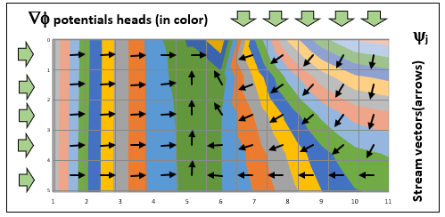
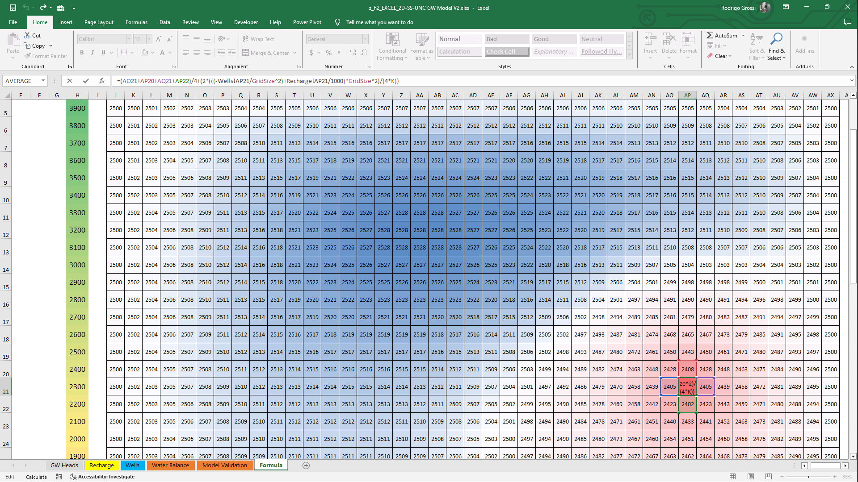
Modelagem Matemática
2D
3D
Excel
Excel

Slide 10
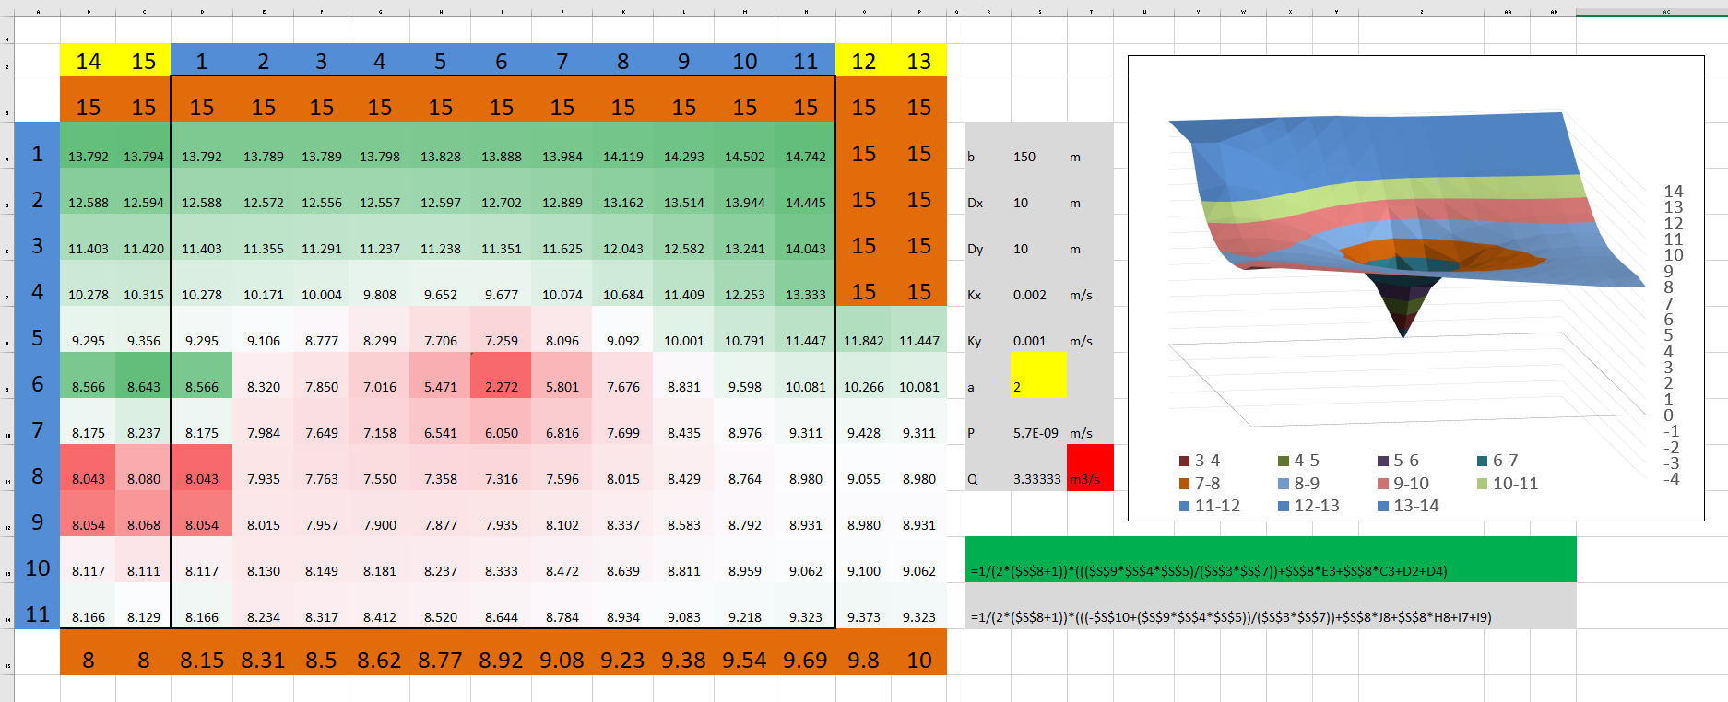
Modelagem Matemática

Slide 11
01- Hvorslev

Slide 12
$$k=\frac{r^{2}Ln\frac{L}{R}}{2L{(t}_{0_{37}\%})}$$
Q$=4πLS/k$
r
R
L

Slide 13
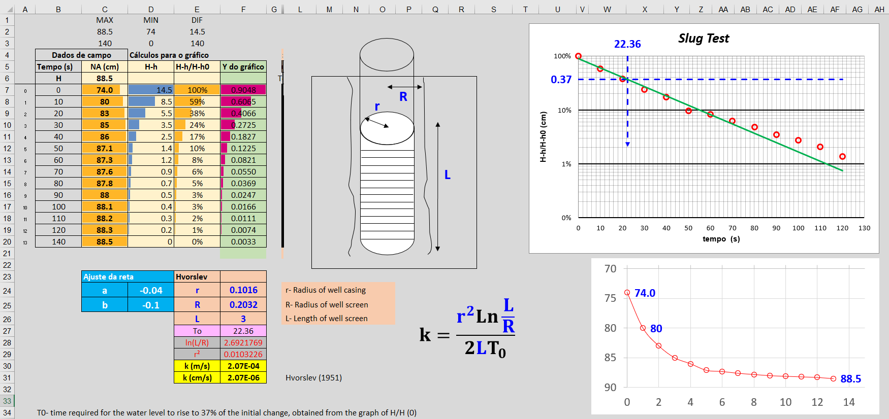
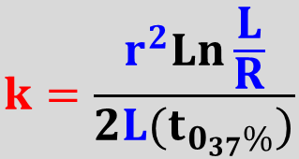
01- Hvorslev
$$k=\frac{r^{2}Ln\frac{L}{R}}{2L{(t}_{0_{37}\%})}$$

Slide 15
TESTES DE BOMBEAMENTO
Q(m³/d)
r
R
L

Slide 16
Q(m³/d)
t₀
t₁
t₂
h₀
t₀
t₃
h₁
t₁
h₂
h_{0, 3}
Skin effect
h₁
Q _{on}
h₂
Q _{off}
t₀
t₁
t₂
t ₃

Slide 18
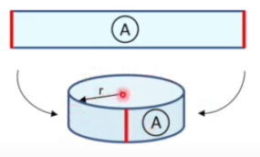
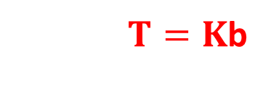
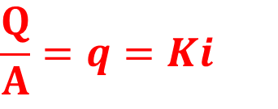
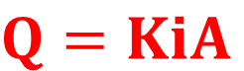
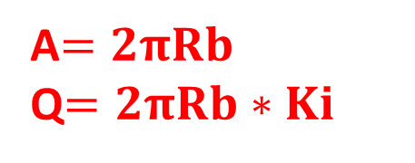
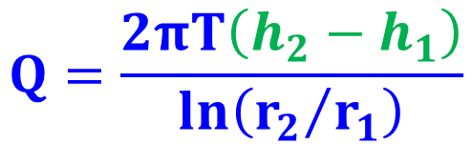

$$Q=KiA$$
$$\frac{Q}{A}=q=Ki$$
_{r2}
_{r1}
b
Q(m³/d)
A$=2πRb$
Q$=2πRb∗Ki$
$T=K$b
$$S_{w}$$
$$Q=\frac{2πT\left(h_{2}−h_{1}\right)}{ln\left({r_{2}}/{r_{1}}\right)}$$
Thiem 1906 – Modelo Estacionário

Slide 19
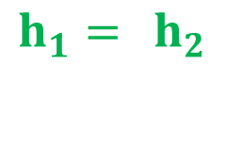
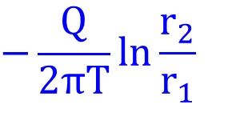
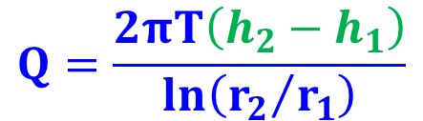
$$Q=\frac{2πT\left(h_{2}−h_{1}\right)}{ln\left({r_{2}}/{r_{1}}\right)}$$
$$−\frac{Q}{2πT}ln\frac{r_{2}}{r_{1}}$$
$$h_{1}={ h}_{2}$$
Q(m³/d)
Rebaixamento (S)
r
Distancia da Bomba
Obs2
Obs1

Slide 20
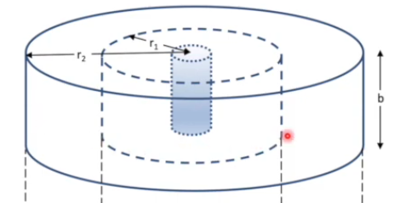
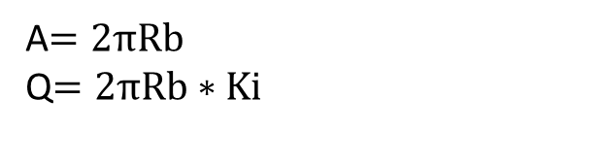
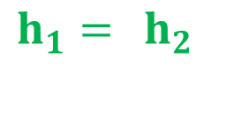
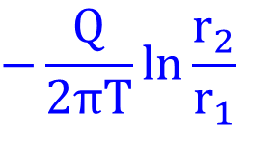
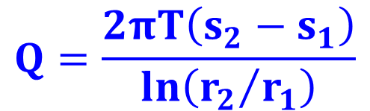
$$−\frac{Q}{2πT}ln\frac{r_{2}}{r_{1}}$$
$$h_{1}={ h}_{2}$$
Rebaixamento (S)
b
Distancia da Bomba
r
A$=2πRb$
Q$=2πRb∗Ki$
Q(m³/d)
$$Q=\frac{2πT\left(s_{2}−s_{1}\right)}{ln\left({r_{2}}/{r_{1}}\right)}$$
Thiem 1906
Steady confined aquifer:

Slide 21
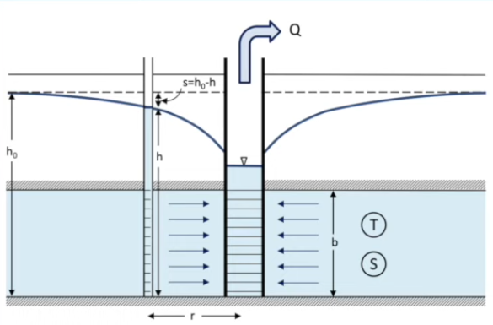
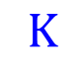
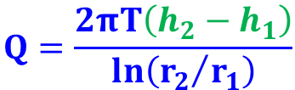

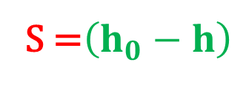
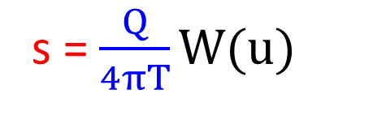
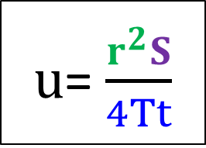
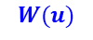
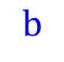
Q(m³/d)
Modelo Dinâmico
(+) W(u)
Armazenamento
Rebaixamento
R₁ R₂
$$W(u)$$
Q(m³/d)
s = $\frac{Q}{4πT}W(u)$
S =$\left(h_{0}−h\right)$
s =
$$T$$
$u$= $\frac{r^{2}S}{4Tt}$
$$K$$
$$b$$
$$Q=\frac{2πT\left(h_{2}−h_{1}\right)}{ln\left({r_{2}}/{r_{1}}\right)}$$
Theis (1935)
R

Slide 22
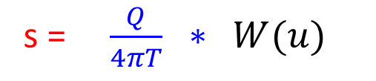
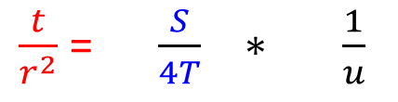
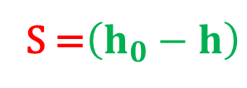
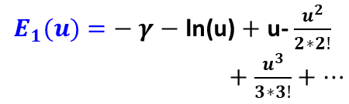
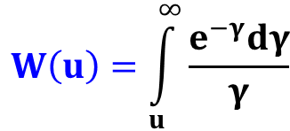
s = $\frac{Q}{4πT} ∗ W(u)$
$\frac{t}{r^{2}}$= $\frac{S}{4T} ∗ \frac{1}{u}$
$$W\left(u\right)=\int_{u}^{∞}{\frac{e^{−γ}dγ}{γ}}$$
$$W(u)$$
Q(m³/d)
$E_{1}(u)$ $=− γ$ $−$ ln(u) $+$ u- $\frac{u^{2}}{2∗2!}$
$+$ $\frac{u^{3}}{3∗3!}+…$
S =$\left(h_{0}−h\right)$
s = $\frac{Q}{4πT}W(u)$
Dinâmico
If u < 1 Then
'Wu = -Log(u) + a0 + u * (a1 + u * (a2 + u * (a3 + u * (a4 + u * a5))))
Dim t As Double
t = (a2 + (u * (a3 + (u * (a4 + (u * a5))))))
Wu = (-1 * Log(u)) + a0 + (u * (a1 + (u * t)))
Else
Wu = Exp(-u) / u * (u * u + b1 * u + b2) / (u * u + b3 * u + b4)
End If
End Function
Armazenamento
s =
$$T$$
$$K$$
$$b$$
Theis (1935)
R

Slide 23
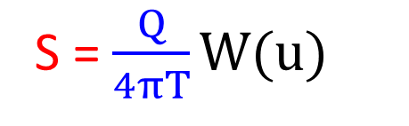
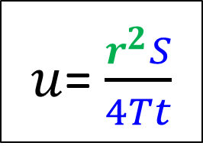
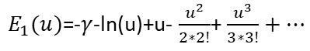
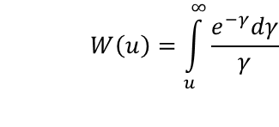
s = $\frac{Q}{4πT} ∗ W(u)$
$\frac{t}{r^{2}}$= $\frac{S}{4T} ∗ \frac{1}{u}$
$$W(u)$$
$$W\left(u\right)=\int_{u}^{∞}{\frac{e^{−γ}dγ}{γ}}$$
Capacidade de armazenamento
S =$\left(h_{0}−h\right)$
Q(m³/d)
S = $\frac{Q}{4πT}W(u)$
$E_{1}(u)$=-$γ$-ln(u)+u- $\frac{u^{2}}{2∗2!}$+ $\frac{u^{3}}{3∗3!}+…$
If u < 1 Then
'Wu = -Log(u) + a0 + u * (a1 + u * (a2 + u * (a3 + u * (a4 + u * a5))))
Dim t As Double
t = (a2 + (u * (a3 + (u * (a4 + (u * a5))))))
Wu = (-1 * Log(u)) + a0 + (u * (a1 + (u * t)))
Else
Wu = Exp(-u) / u * (u * u + b1 * u + b2) / (u * u + b3 * u + b4)
End If
End Function
S =
$$T$$
$u$= $\frac{r^{2}S}{4Tt}$
$$K$$
$$b$$
Theis (1935)
(r)

Slide 24
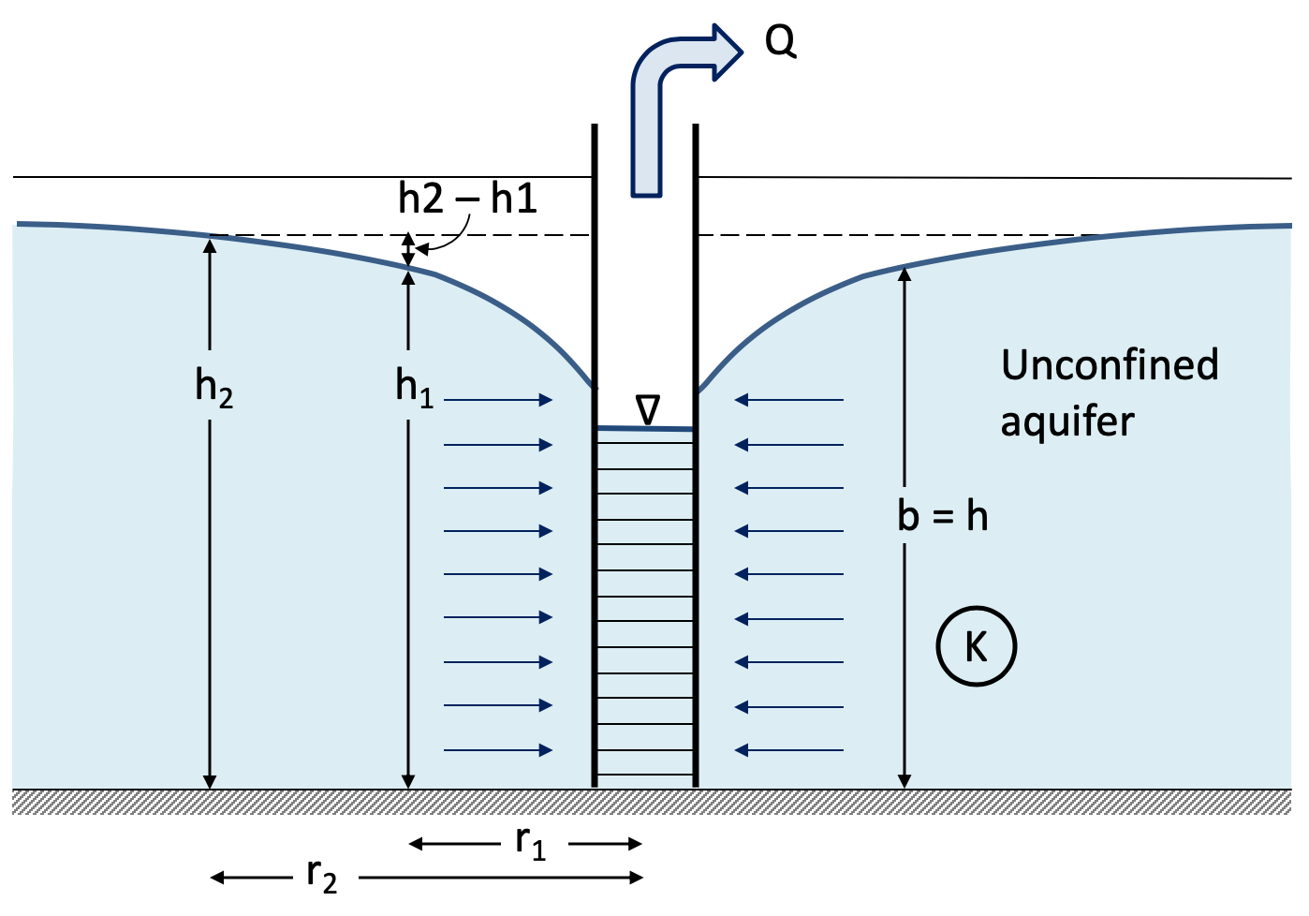
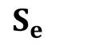
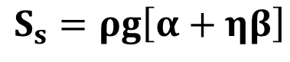
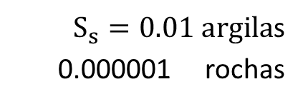
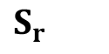









$$η$$
Porosidade total
$$S_{r}$$
Retenção específica
$$η_{e}$$
Porosidade efetiva
$$S_{e}$$
Vazão específica
Livre Confinado
Coeficiente
de armazenamento
$$S=\frac{Q}{A∗(H_{2}−H_{1})}$$
$S_{w}=S_{y}$ + $h_{0} S_{s}$
$S_{y}≫$ $h_{0} S_{s}$
$$Q=0.001∗\left(10km x 10km\right)∗\left(50m\right)=5x106 \left(m3\right)$$
$S_{s}=0.01 argila$s
0.000001 rochas
$$S_{s}=ρg\left[α+ηβ\right]$$
$$β=\frac{\text{−}\text{d}\text{(}\text{Vw}\text{/}\text{Vw}\text{)}}{dP}$$
compressibilidade
s = $\left(h_{0}−h\right)$
Q(m³/d)
$$h_{0}$$
$$S= S_{s}∗b$$
b

Slide 25
$$η$$
Porosidade total
$$S_{r}$$
Retenção específica
$$η_{e}$$
Porosidade efetiva
$$S_{e}$$
Vazão específica
Livre Confinado
Coeficiente
de armazenamento
$$S=\frac{Q}{A∗(H_{2}−H_{1})}$$
$S_{w}=S_{y}$ + $h_{0} S_{s}$
$S_{y}≫$ $h_{0} S_{s}$
$$Q=0.001∗\left(10km x 10km\right)∗\left(50m\right)=5x106 \left(m3\right)$$
$S_{s}=0.01 argila$s
0.000001 rochas
$$S_{s}=ρg\left[α+ηβ\right]$$
$$β=\frac{\text{−}\text{d}\text{(}\text{Vw}\text{/}\text{Vw}\text{)}}{dP}$$
compressibilidade
s = $\left(h_{0}−h\right)$
Q(m³/d)
$$h_{0}$$
$$S= S_{s}∗b$$
b

Slide 26






$$\frac{Q}{A}Ki=ln\frac{∆H}{∆L}$$
$T=K$b
Modelo Dinâmico
(+) W(u)
Armazenamento
b
$Ss=m3/m3$ / $m=\left(\frac{1}{m}\right)$
a
Aq.
drop
Armazenamento específico
Modelo Estacionário
$$S=Ss∗b$$
Armazenamento total

Slide 27
$$\frac{Q}{A}Ki=ln\frac{∆H}{∆L}$$
$T=K$b
Modelo Dinâmico
(+) W(u)
Armazenamento
b
$Ss=m3/m3$ / $m=\left(\frac{1}{m}\right)$
a
Aq.
drop
Armazenamento específico
Modelo Estacionário
$$S=Ss∗b$$
Armazenamento total

Slide 29


Modelo Dinâmico
3
(+) W(u)
Armazenamento
01
02
Simplifica
S = $\frac{Q}{4πT}W(u)$
Cooper & Jakob, 1946

Slide 30





3
01
R
Simplifica
S =$\left(h_{0}−h\right)$
S = $\frac{Q}{4πT}W(u)$
Rebaixamento
$S$ = $\frac{Q}{4πT}ln$
$$\left(−0.5772−ln\frac{r^{2}S}{4Tt}\right)$$
Cooper & Jakob, 1946

Slide 31







$$∆S$$
s = $\frac{Q}{4πT}W(u)$
Rebaixamento (S)
$u$= $\frac{r^{2}S}{4Tt}$
$S$= $\frac{Q}{4πT}ln$
$$\left(−0.5772−ln\frac{r^{2}S}{4Tt}\right)$$
$T=$
S =
Cooper & Jakob, 1946

Slide 32

4
15,000 m3/d
r₁ r₂
Thiem 1906
50 m
10.000 m
40.000 m
AQ não confinado
37.61 m/d
600 m
0.5 m
R
Theis
Cooper & Jakob
$$Q=\frac{2πK\left(h_{2}^{2}−h_{1}^{2}\right)}{ln\left({r_{2}}/{r_{1}}\right)}$$
Capacidade de armazenamento
Aq. Livre
Dupuit-Forchheimer (1805)

Slide 33









4
$$A=\frac{Q}{R}=\frac{\frac{50L}{sec}∗\frac{86400}{1000}}{0.012 m/day}=3.600.000 m2$$
15,000 m3/d
$$r_{0} =\sqrt{\frac{A}{π}}=\sqrt{\frac{3.600.000 m2}{π}}=1.071 m$$
50 m
10.000 m
40.000 m
AQ não confinado
37.61 m/d
600 m
0.5 m
$$Q=\frac{2πK\left(h_{2}^{2}−h_{1}^{2}\right)}{ln\left({r_{2}}/{r_{1}}\right)}$$
$$h_{1}=\sqrt{h_{2}^{2}−\frac{Qln\left({r_{2}}/{r_{1}}\right)}{πK}}$$
Dupuit-Forchheimer (1805)
$$−\frac{Q}{2πT}ln\frac{r_{2}}{r_{1}}$$
$$h_{1}=h_{2}$$

Slide 34








Dupuit-Forchheimer (1805)
$$A=\frac{Q}{R}=\frac{\frac{50L}{sec}∗\frac{86400}{1000}}{0.012 m/day}=3.600.000 m2$$
$$Q=\frac{2πK\left(h_{2}^{2}−h_{1}^{2}\right)}{ln\left({r_{2}}/{r_{1}}\right)}$$
$$r_{0} =\sqrt{\frac{A}{π}}=\sqrt{\frac{3.600.000 m2}{π}}=1.071 m$$
$$K=\frac{Qln\left({r_{2}}/{r_{1}}\right)}{π\left(h_{2}^{2}−h_{1}^{2}\right)}$$
$$1.071 m$$
Recharge irrigation
1.2x10^-3 m/day
1.2mm/day ... 438mm/year
0.0012 m/day
$$h_{1}=\sqrt{h_{2}^{2}−\frac{Qln\left({r_{2}}/{r_{1}}\right)}{πK}}$$
$$h_{2}=\sqrt{\frac{Qln\left({r_{2}}/{r_{1}}\right)}{πK}+h_{1}^{2}}$$
0.981 m³/sec
750 L/sec irrigação Cabul
https://pubs.usgs.gov/sir/2009/5262/

Slide 35



6
Newman
Teste escalonado

Slide 36







Dupuit-Forchheimer (1805)
$$h_{1}=\sqrt{h_{2}^{2}−\frac{Qln\left({r_{2}}/{r_{1}}\right)}{πK}}$$
$$1.071 m$$
$$3.900 m$$
$$h_{2}=\sqrt{\frac{Qln\left({r_{2}}/{r_{1}}\right)}{πK}+h_{1}^{2}}$$
$$A=\frac{Q}{R}=\frac{\frac{50L}{sec}∗\frac{86400}{1000}}{0.012 m/day}=3.600.000 m2$$
$$r_{0} =\sqrt{\frac{A}{π}}=1.071 m$$

Slide 37


5
Leaky Confined Aquifer
S =$\left(h_{0}−h\right)$
Q(m³/d)
c
1/c
Hantush & Jacob (1955)
R

Slide 38







5
$$s=\frac{Q}{4πT} W(u,r/B)$$
$$u= \frac{r^{2}S}{4Tt}$$
$s=$ $\frac{Q}{4πT}\int_{u}^{∞}{\frac{1}{γ}}exp\left(γ−\frac{r^{2}}{4B^{2}πγ}\right)dy$
$$B=\sqrt{{{Tb}^{′}}/{K_{z}^{′}}}$$
Fator de drenança
$$c={b^{′}}/{K_{z}^{′}}$$
Resistência hidráulica
$$1/c={{K_{z}^{′}}/{b^{′}}=T}/{B^{2}}$$
S =$\left(h_{0}−h\right)$
Q(m³/d)
Drenança
r/B =
b'(m) =
T(m2/d) =
S =
B(m) =
c(days) =
1/c (d-1) =
K'(m/d) =
c
1/c
Hantush & Jacob (1955)
R

Slide 39








Hantush & Jacob (1955)
Leaky Confined Aquifer
$$s=\frac{Q}{4πT} W(u,r/B)$$
$$u= \frac{r^{2}S}{4Tt}$$
$u$= $\frac{r^{2}S}{4Tt}$
s = $\frac{Q}{4πT}W(u)$
Theis
$s$= $\frac{Q}{4πT}\int_{u}^{∞}{\frac{1}{γ}}exp\left(γ−\frac{r^{2}}{4B^{2}πγ}\right)dy$
24,466 m³/d
$$B=\sqrt{{{Tb}^{′}}/{K_{z}^{′}}}$$
Fator de drenança
c
4.2672 m
1/c
$$c={b^{′}}/{K_{z}^{′}}$$
Resistência hidráulica
3,521 m²/d
1.17E-03
$$1/c={{K_{z}^{′}}/{b^{′}}=T}/{B^{2}}$$
Drenança
12 m

Slide 40
7
Q(m³/d)
t₀
h_{Well}
t₁
t₀
t₂
t
t₁
Δs
t₃
Skin effect
t
https://www.waterloohydrogeologic.com/help/aquifertest/index.html?at_chapter78.htm

